Slide 2
3rd midterm
Quiz 3 (= Midterm Exam 3) covers material from modules 6, 7, 8 in the course, online at home
You are allowed one attempt to complete the quiz. There is a time limit of 60 minutes to complete the quiz after you start it.
Different to the previous quizzes, answers are NOT locked.
There are 40 multiple choice/fill-in-the-blank questions (2 points each), and four short essay questions (5 points each).
Open book, notes, etc. (Respondus browser NOT required).
The quiz will be taken online at home!
Time window: 7:00 am to 11:59 pm
1 hr time limit once started, you need to start before 10:59 pm to have the 1 hr.
Date: Thursday, April 9
No other assignments on April 9.

Slide 3
Chapter 6 – Key points
How can air be uplifted?
Orographic, frontal, convergence, convective
What are the different lapse rates?
SALR, DALR, ELR
What does their relative magnitude tell us about stability?
Why is knowing the stability important?
What has all the above to do with cloud formation?
Thermodynamic diagrams and forecasting
How to limit lifting of air/cloud formation?
Stable air layers, entrainment
Cloud types
Appearance, height, why different?
Overall, what are the key ingredients for cloud formation and development?

Slide 4
Mechanisms That Lift Air
When air lifts, clouds develop and precipitation can also occur.
There are four mechanisms that cause air to lift.
Orographic lift Forcing air above a mountain barrier
Frontal lift Displacement of one air mass over another
Convergence Horizontal movement of air
Convection Localized, buoyancy
Adiabatic cooling when lifted upward @ DALR. When lifted to lifting condensation level, SALR replaces DALR. Convective clouds when saturated air has positive buoyancy (level of free convection), air parcel warmer than surrounding. Key is the comparison of ELR and DALR, SALR.

Slide 5
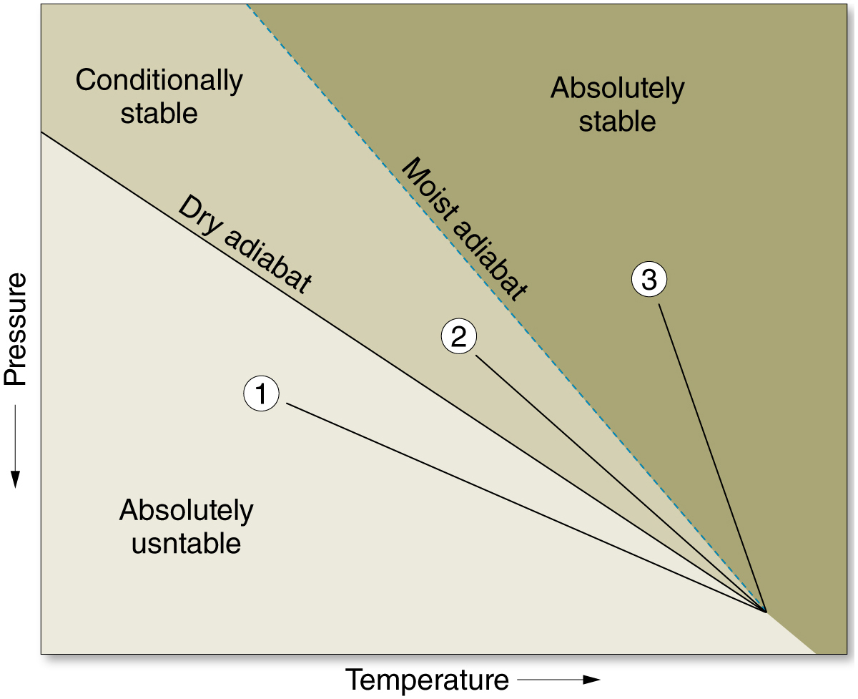
Stability from Thermodynamic Diagram
1, 2, 3: measured temperature profiles, e.g., radiosonde
Examples:
ELR=1.5 ºC/100 m > DALR=1 ºC/100 m (air always rising)
DALR=1 ºC/100 m > ELR=0.8 ºC/100 m > SALR=0.5 ºC/100 m (air rising if saturated, no rising if dry)
ELR=0.3 ºC/100 m < SALR=0.5 ºC/100 m (air never rising)

Slide 6
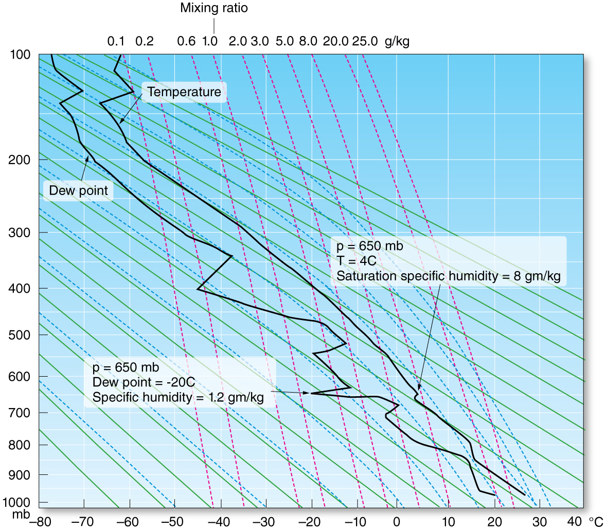
Stuve chart and Forecasting
Dry adiabats
Moist adiabats
Saturation Mixing ratio for each combination of T and pressure
Measured T and dew point
Vertical view of atmosphere
Pressure on vertical axis
All lapse rates -> stability
Help predict severe weather
Severe weather (convective instability): lifting an entire layer (warm & moist at bottom; cold and dry at top) would result in a dramatic change of ELR b/c bottom would become saturated and cool less quickly than top, ELR much bigger.
Fast changes in ELR more likely above planetary boundary layer, because turbulence in PBL “equalizes” ELR

Slide 7
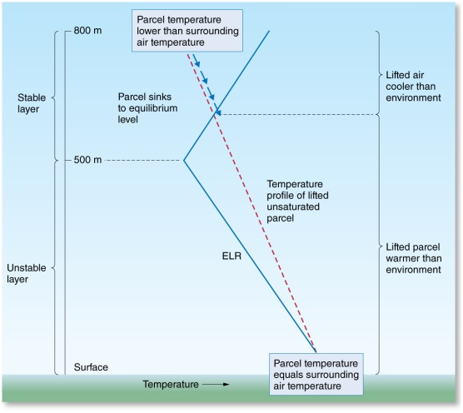
Limitations on the Lifting of Unstable Air
What causes air to stop rising?
Stable air
Inversions, air parcel becomes colder than surrounding, less buoyant.
Entrainment (mixing): Occurs when turbulence causes air to mix.
Entrainment can suppress the growth of clouds by introducing unsaturated air.
Evaporation of cloud droplets, need latent heat, get this by making cloud margins cooler -> less buoyant -> limit lifting
So, it’s all about T relative to surrounding and buoyancy (cold air more dense)
Layer of stable air.

Slide 8
Cloud Types
They are subdivided into classes based on appearance and/or height.
Appearance
Cirrus – thin, wispy clouds of ice
Stratus – layered
Cumulus – vertical development
Nimbus – rain producing
Height
High clouds – Cirro… (above 6000 m)
Middle clouds – Alto… (2000 – 6000 m)
Low clouds – …stratus… (below 2000 m)
Clouds of vertical development – …cumulus…
See foldout in book

Slide 9
Chapter 7 – Key points
Learned about cloud formation in ch 6. But not all clouds precipitate. Why? What’s required? When do we get rain, hail, snow? Where and when?
Why cloud droplets don’t fall and raindrops do – terminal velocity Gravity, air resistance (drag). Balance between gravity and drag depends on size
Droplet growth in warm and cold clouds: collision-coalescence; Bergeron process, aggregation Droplet growth limited by amount of water vapor. Large drops that precipitate need to grow further through collision and coalescence in warm clouds (always > 0 ºC), and through ice crystal growth at the expense of supercooled droplets in cold clouds (Bergeron process, saturation vapor pressure over ice lower), followed by aggregation.
Lake snow effect – warm lake, cold dry air blowing over lake, convergence and clouds over land close to lake
Rain, snow, sleet, freezing rain, graupel – depends on temperature profile between cloud and ground
Hail – up and downdrafts in cumulonimbus clouds, tree-ring like growth of ice (cloud has very different T at top and bottom because of its vertical extent)
How to measure precipitation? – Doppler radar, rain gauges

Slide 10
Terminal Velocity
How fast does a water droplet fall in the atmosphere?
SIZE MATTERS!
F_{gravity} = m_{water} * g
= ρ_{water} * Vol * g
= ρ_{water} * 4π/3 * r³ * g
F_{drag} = constant * A * v²
= constant * 4π * r² * v²
F_{drag} = constant * r * v
F_{gravity} = F_{drag} - if balanced (terminal velocity reached)
r: droplet radius
g: Earth’s gravity acc.
Vol: droplet volume
A: droplet surface
v: droplet velocity
Terminal velocity v = constant2 * √r - proportional to square-root of droplet radius
Small cloud droplets will fall very slowly – more or less suspended in air
Large drops will fall much faster – will overcome updrafts -> rain, precipitation

Slide 11
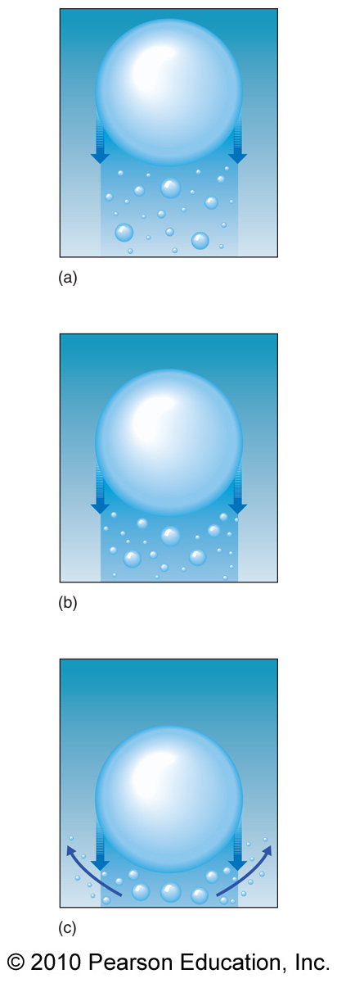
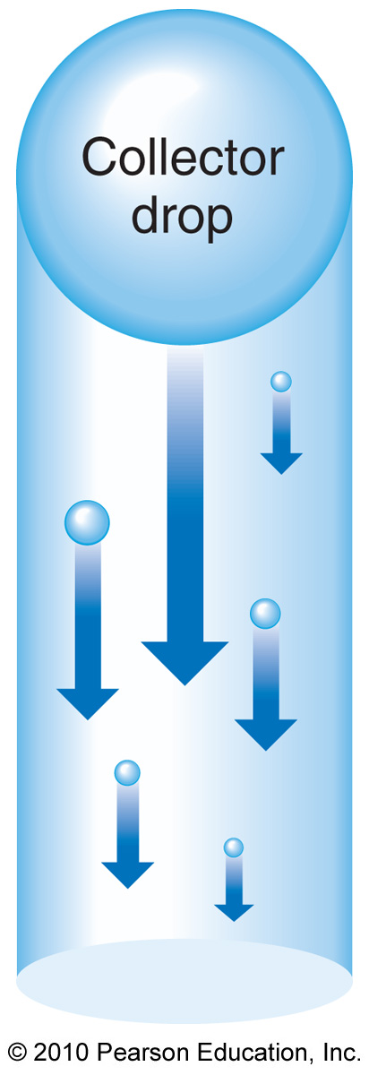
Growth of Cloud Droplets, warm clouds
Collisions cause
coalescence
Not efficient if collector drop too large
Larger collector drops have larger terminal velocities and overtake smaller drops.
Smallest drops swept aside, rest sticks together (coalescence)
Dominant in tropics where clouds are at or above 0ºC

Slide 12
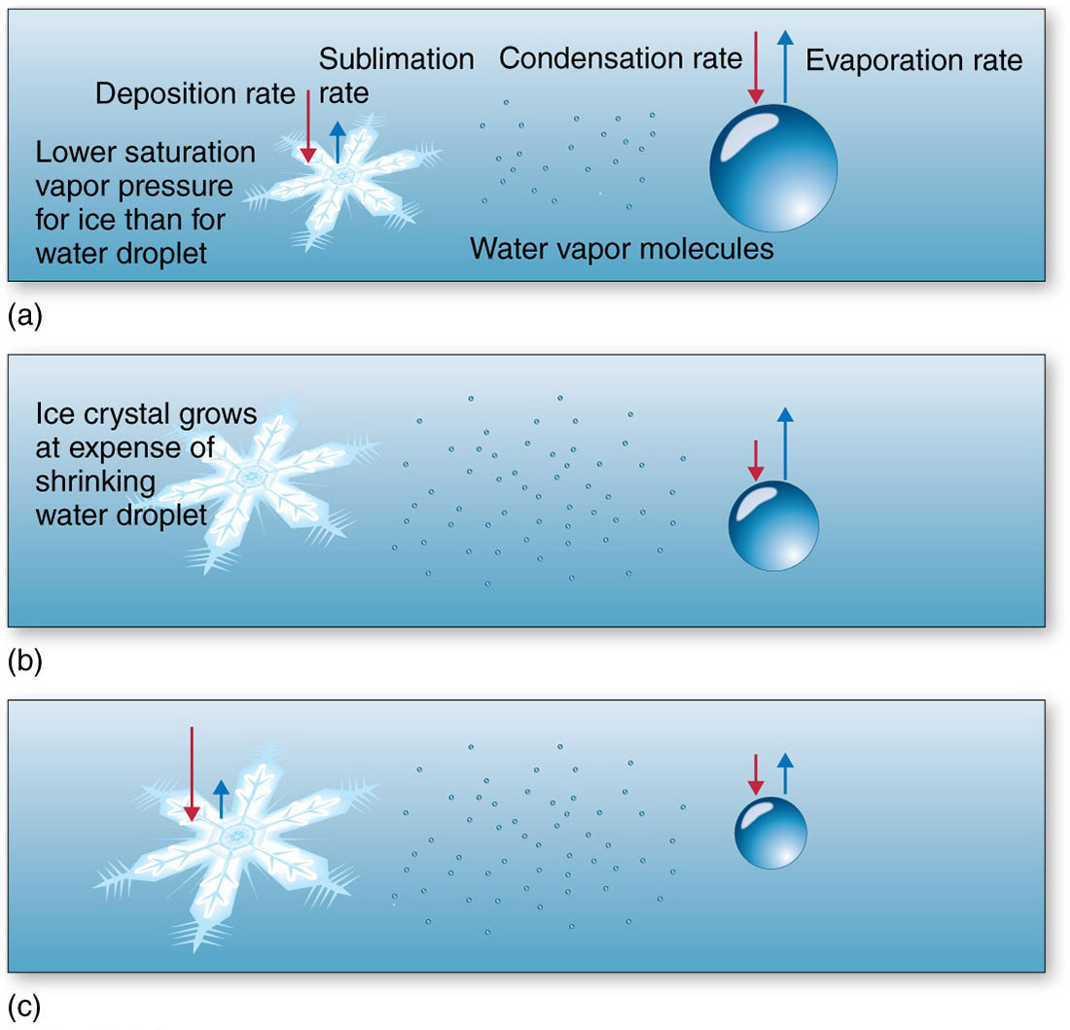
Growth of Cloud Droplets
Growth in Cold and Cool Clouds – Bergeron Process
Saturation vapor pressure of ice is less than that of supercooled water and water vapor.
During coexistence, water will sublimate directly onto ice.
Ice crystals grow rapidly at the expense of supercooled drops.
Collisions between falling crystals and drops causes growth through riming (freezing of water on ice) and aggregation (joining of ice crystals).
Precipitation out of cold clouds is snow, can be melted on way down (rain).

Slide 13
Forms of Precipitation
Takes about 30 minutes for the ice crystals to be large enough to fall – after the initial formation of ice crystals in the cloud
We always get ice crystals from the clouds (at middle latitudes, Bergeron process)
Snow: air below cloud cold enough to prevent melting
Rain: air below cloud warm enough to melt the crystals
Sleet: deep air layer close to the surface cold enough to freeze the rain
Freezing rain: thin air layer close to the surface cold enough to produce supercooled water

Slide 14
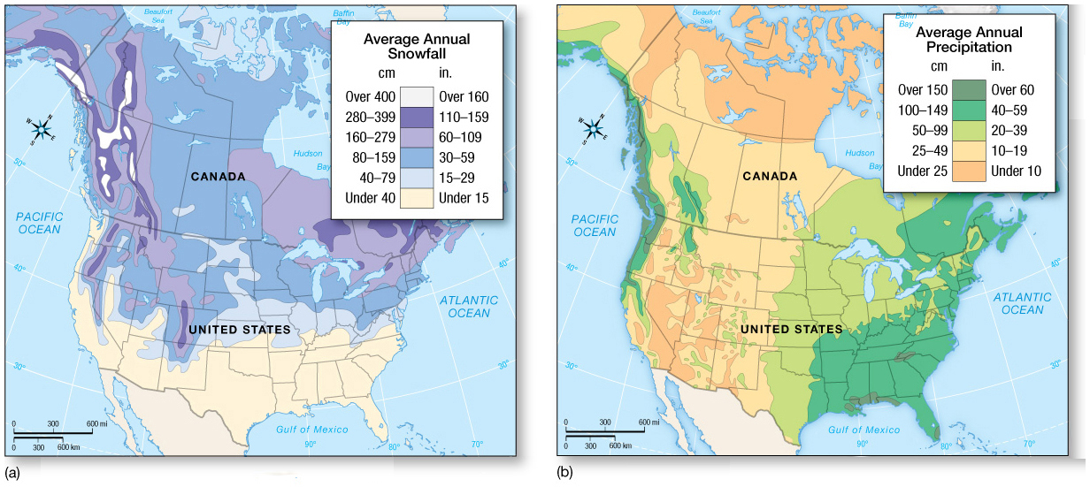
Distribution and Forms of Precipitation
Snow
Snowfall distribution in North America is related to north–south alignment of mountain ranges (orographic uplift) and the presence of the Great Lakes (moisture).

Slide 15
all ice
Anvil
- 40 ° C
- 15 ° C
Large updrafts
0 ° C
Melting (partly)
+8 ° C
„Cumulonimbus
congestus/incus“ =
Big thunderstorm
Rain or graupel or hail
Cycle can be repeated many times,
if violent updrafts = larger hailstones

Slide 16
Chapter 8 – Key points
Atmospheric scales – global (e.g., jet streams), synoptic (e.g., high and low pressure systems), meso (e.g., T-storm system), micro
Global wind patterns
Three cell model; alternating belts of low and high pressure; rising and sinking motion
Hadley, Ferrel, polar cells
ITCZ, trade winds, wind direction as function of latitude
Wind systems: Monsoon, Santa Ana, Sea breeze
Jet stream
Polar and subtropical, both are westerlies
Global warming, polar jet stream and “arctic blast”
Ocean currents
Driven by global wind systems, 45 deg angle
Ekman spiral
El Nino/La Nina
Complex interplay of west-east winds in Pacific and ocean
Warming of eastern Pacific (El Nino), cooling (La Nina)
Global weather impact, e.g., cold and wet in SC during El Nino

Slide 17
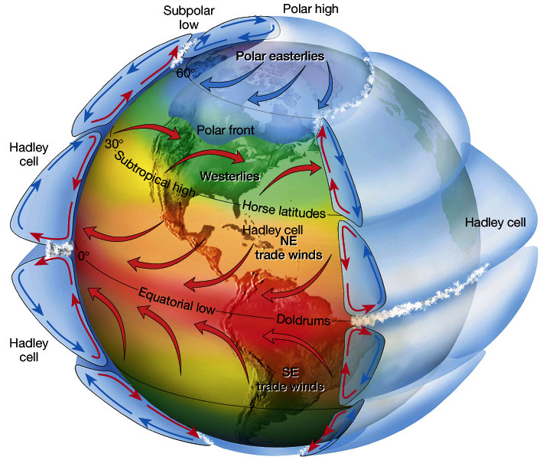
The Concept of Scale
Global scale, e.g., global wind systems

Slide 18
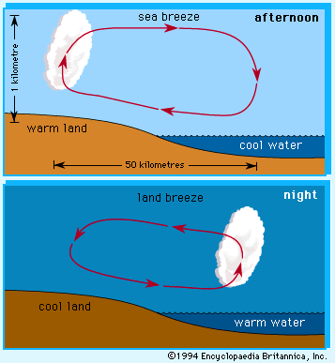
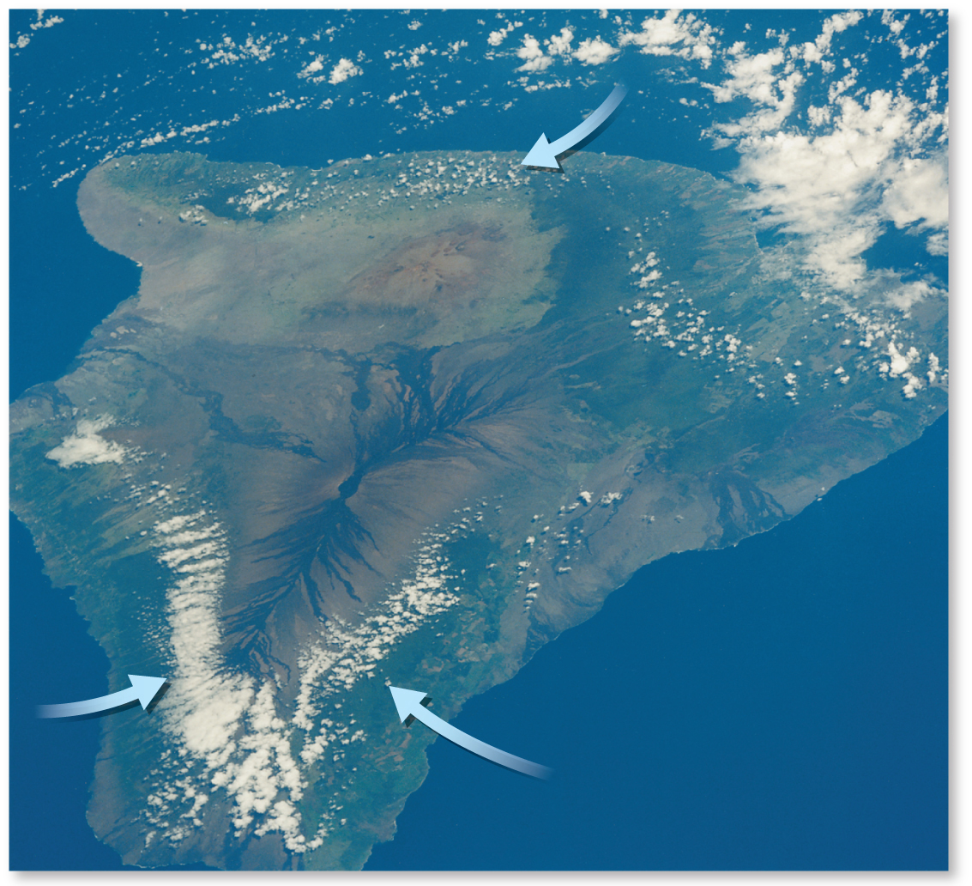
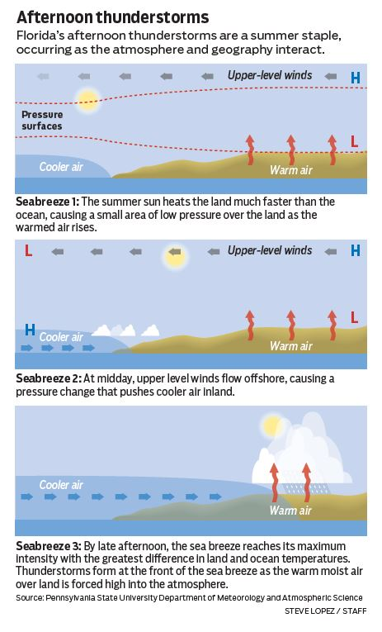
Sea and Land Breezes – mesoscale
Sea breezes (mesoscale)
Cloud development,
somewhat inland, mostly afternoon,
Thermally driven
Florida afternoon T-storms at the front of the sea breeze

Slide 19
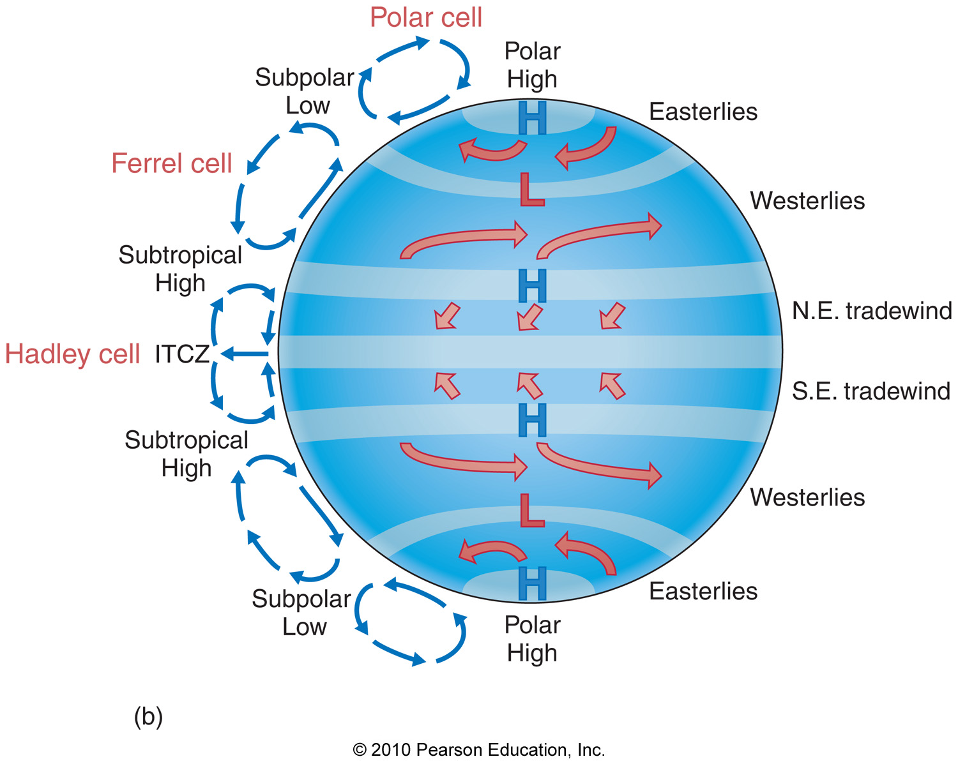
The Three-Cell Model – global scale
Three pressure cells per hemisphere (ok @ surface)
For upper-air motions, the three-cell model is unrepresentative. There, the always westerly winds are driven by the PGF (South to North + Coriolis)
Alternating easterlies/westerlies at surface (result of Coriolis force to the right in NH)
Ferrell, 1865

Slide 20
The Three-Cell Model
Three pressure cells per hemisphere
Hadley cell
Between 0º and 30º latitude; NE, SE trade winds
Thermally driven tropical cell
More heating at the equator than in the subtropics
Equatorial low, or intertropical convergence zone (ITCZ)
Doldrums: Clouds, precipitation (rainiest latitudes)
Migrates with vertical solar angle; seasonally
Strongest in winter when temperature gradients are the strongest
Subsidence area at 30º (subtropical high, Horse latitudes)
Dry, arid climate and low wind speeds

Slide 21
Semipermanent Pressure Cells – syntoptic
Instead of cohesive pressure belts circling Earth, semipermanent cells of high and low pressure exist, fluctuating in strength and position on a seasonal basis.
These cells are either dynamically or thermally created.
For the Northern Hemisphere they include:
The Aleutian, Icelandic, and Tibetan lows
Siberian, Hawaiian, and Bermuda-Azores highs
Sinking motions associated with the subtropical highs promote desert conditions across specific latitudes.
Seasonal fluxes in the pressure belts relate to the migrating Sun (solar declination).

Slide 22
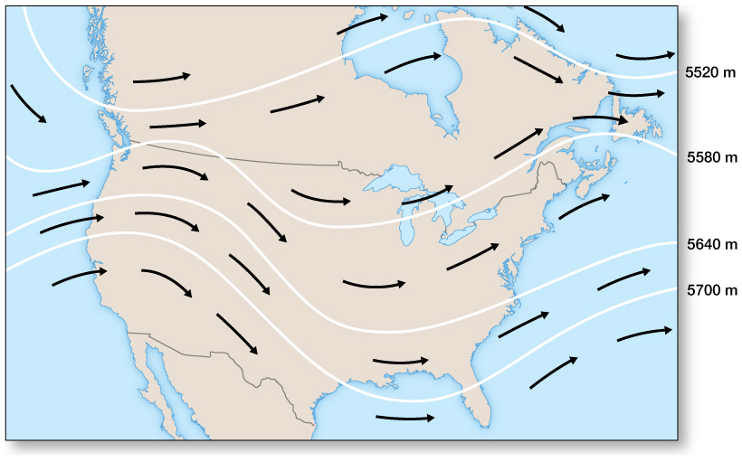
The Upper Troposphere
Upper troposphere westerlies
Circulation cells based on rising/sinking air; resulting wind patterns ok close to surface
Upper troposphere: need to add the general westerlies from tropical/polar temperature difference (see Module 4)
Colder/denser air at poles;
Coriolis deflection; westerlies in upper troposphere

Slide 23
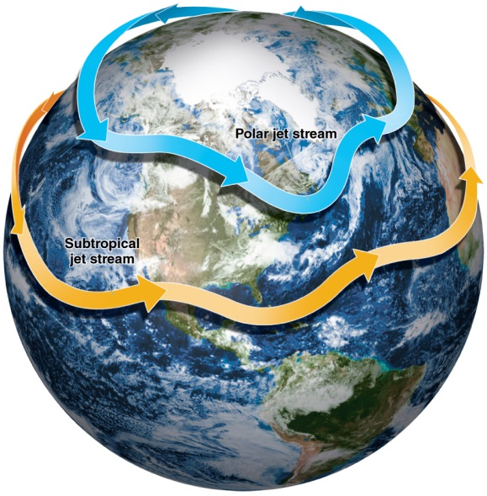
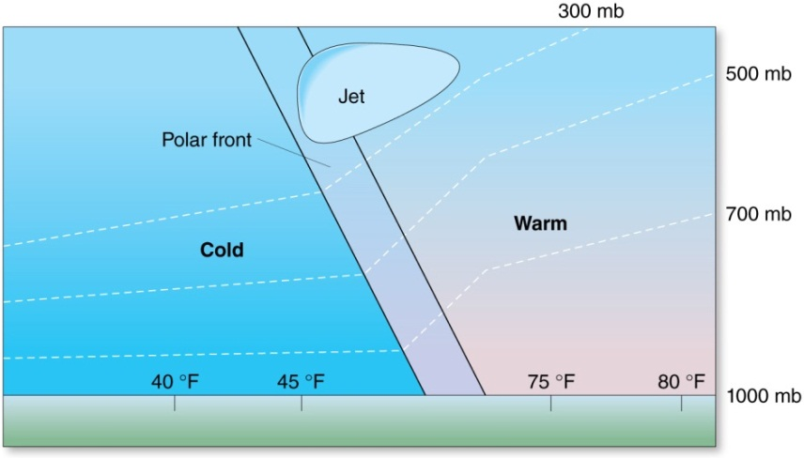
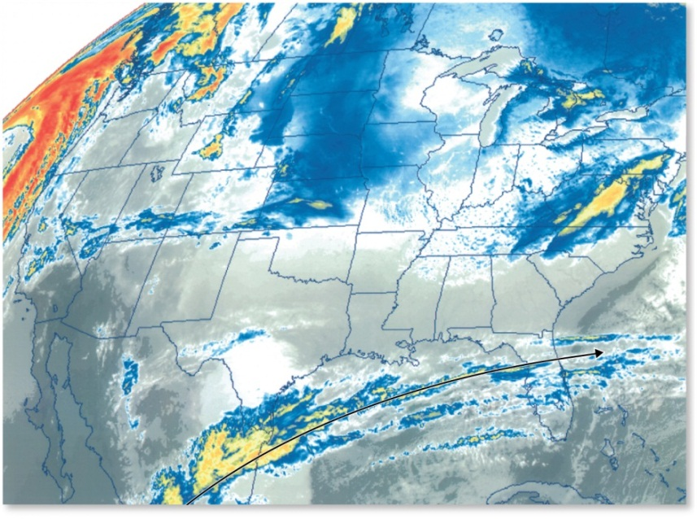
The Upper Troposphere
The Polar Front and Jet Streams
Subtropical jet stream

Slide 24
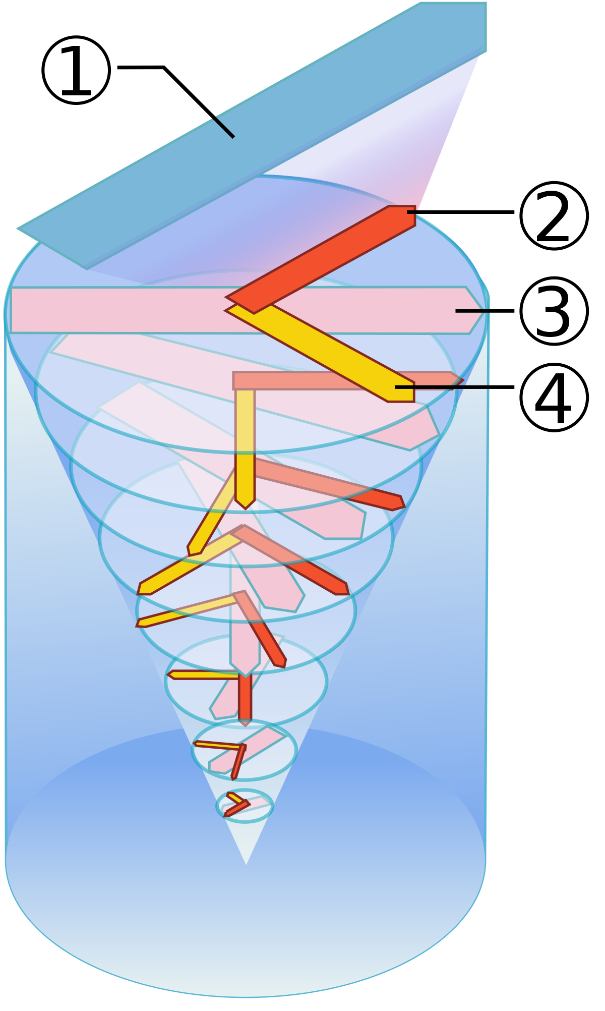
The Oceans – Ekman spiral
Wind
Drag force on ocean surface from above
Wind tries to move a thin layer of surface water in the direction of the red arrow
BUT, the moving water is now subject to the Coriolis force (4)
3. Resulting effective direction of the surface flow at the very top of the ocean, 45 deg relative to wind.
This cycle now repeats with the layer of water directly below the top layer; (3) has now the role of (1) and everything repeats – the current in the second layer rotates clockwise
But friction between the two water layers (b/c they move into different directions) slows the motion.
The result is a spiraling motion with weakening currents toward greater depths.

Slide 25
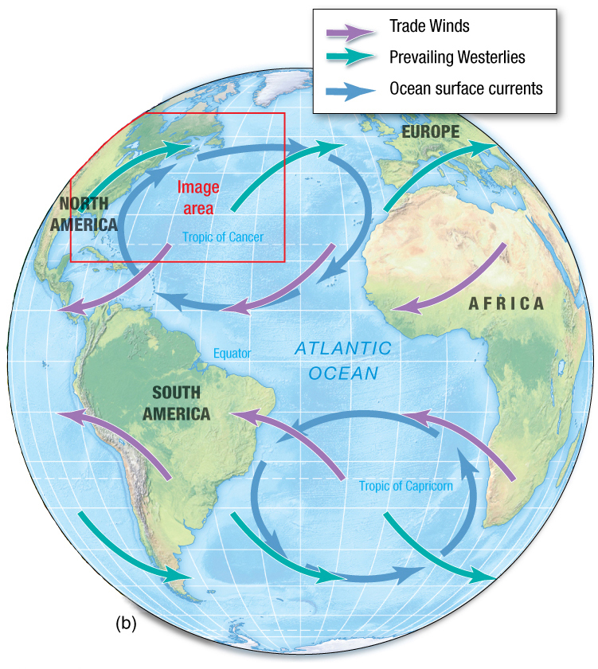
The Oceans
Three-cell model + Coriolis force
+ Ekman Spiral
Ocean currents driven by surface winds explained by 3-cell model,
45 deg angle.
= General structure of ocean currents

Slide 26
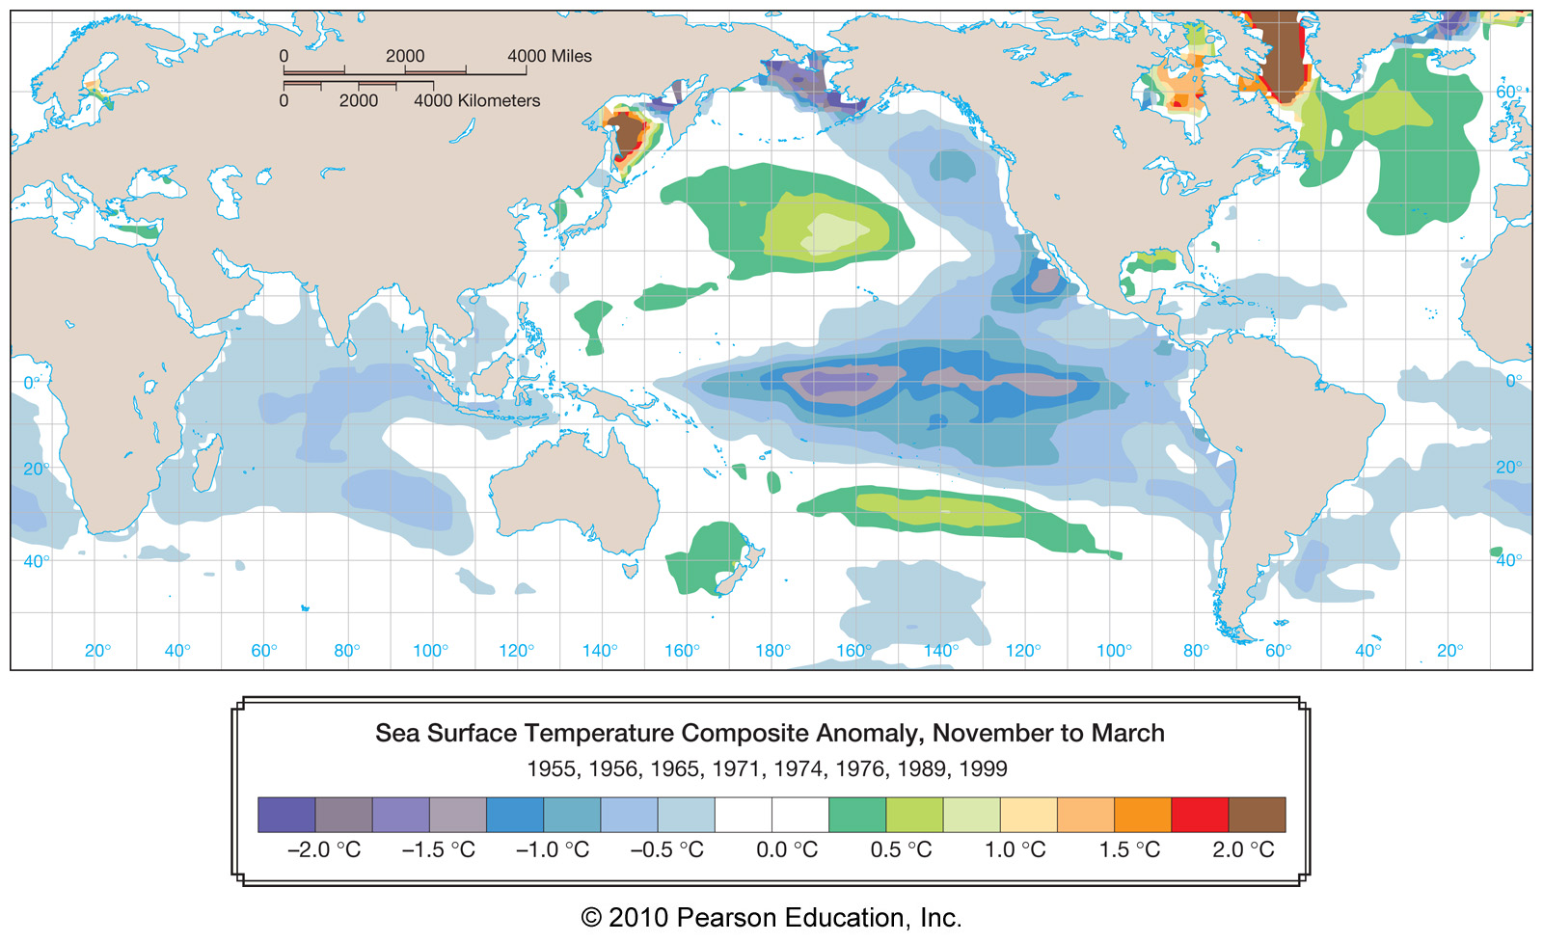
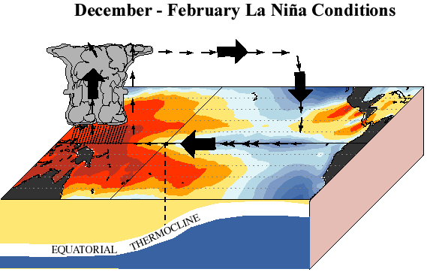
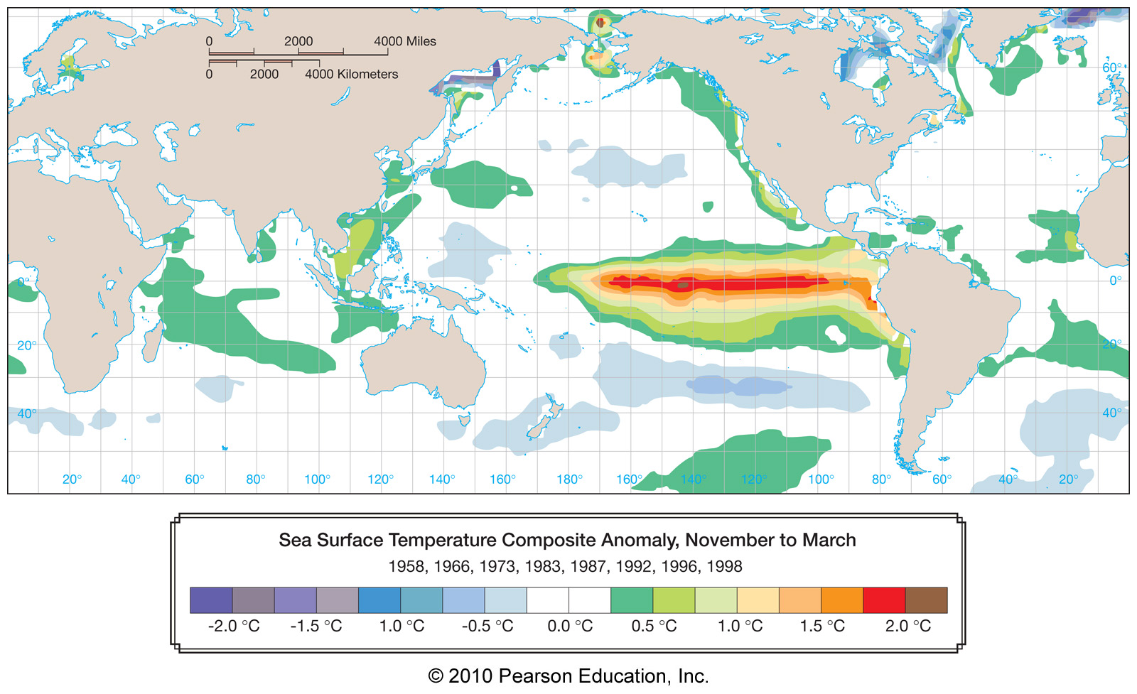
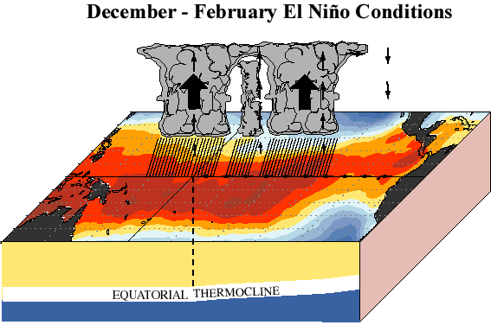
Ocean–Atmosphere Interactions
Walker circulation particularly strong
Walker circulation weak

Slide 27
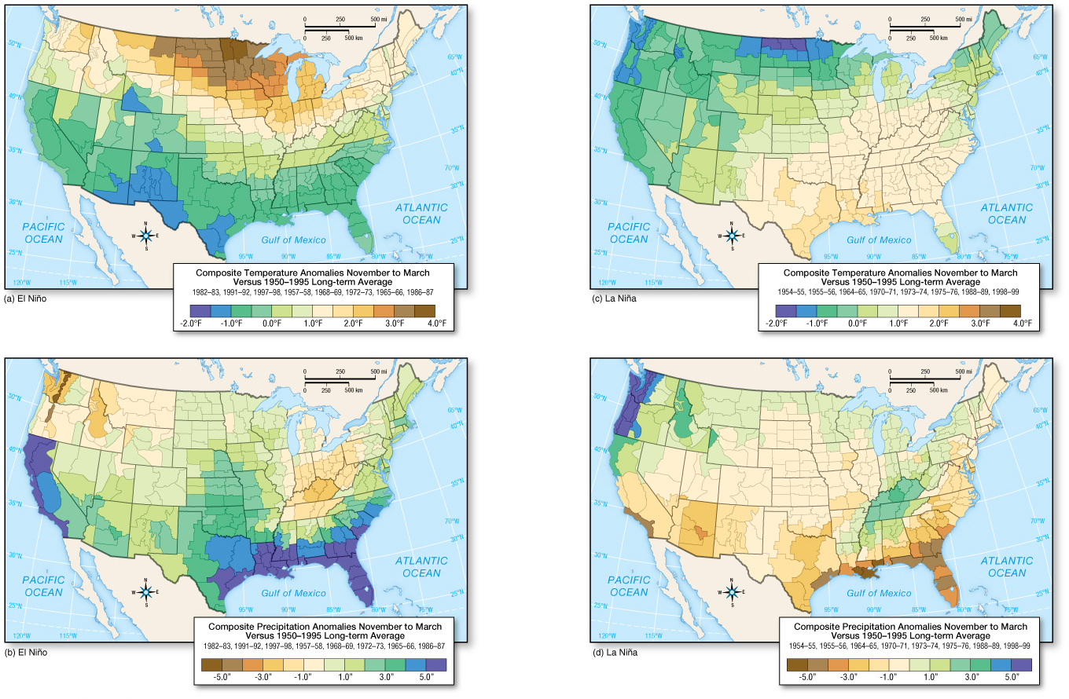
Ocean–Atmosphere Interactions
SC wet and cold during El Nino
Average T and precipitation impacts of ENSO

